Slide 1

Software QUALITY ENGINERING
Testing strategies and Model-based testing

Slide 2
White Box testing

Slide 3
Model-based testing
Model-based testing is a software testing technique in which the test cases are derived from a model that describes the functional aspects of the system under test.
It makes use of a model to generate tests that includes both offline and online testing.

Slide 4
White box testing
WhiteBox testing in software engineering aims to make sure that all decision branches, loops, and statements in the code are correct.
Code Coverage Analysis is a popular White box testing technique.
It is software testing technique in which internal structure, design and coding of software are tested to verify flow of input-output and to improve design, usability and security.
In white box testing, code is visible to testers so it is also called Clear box testing, Open box testing, Transparent box testing, Code-based testing and Glass box testing.

Slide 5
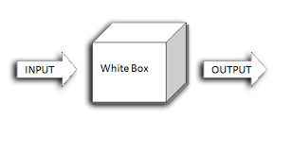
White box testing
In white box testing, the tester has to go through the code line by line to ensure that internal operations are executed as per the specification and all internal modules are properly implemented.

Slide 6
Model-based testing
There are numerous models available, and it describes different aspects of the system behavior.
Examples of the model are:
Data Flow Testing
Control Flow Testing
Dependency Graphs Testing
Decision Tables Testing
State transition machines Testing
Finite State Machine Coverage Testing
Path Testing
Loop Testing

Slide 7
Cont…
Model-Based Testing describes how a system behaves in response to an action (determined by a model). Supply action, and see, if the system responds as per the expectation.
It is a lightweight formal method to validate a system. This testing can be applied to both hardware and software testing.

Slide 8
Control Flow Graphs (cfg)
Control flow testing is a type of software testing that uses program’s control flow as a model. Control flow testing is a structural testing strategy.
This testing technique comes under white box testing.
For the type of control flow testing, all the structure, design, code and implementation of the software should be known to the testing team.
A CFG is a directed graph G = (N, E) where each node, in the set N, is either a statement node or a predicate node.
–A statement node represents a simple statement. Alternatively, a statement node can be used to represent a basic block and a predicate node represents a conditional statement.
–Each edge, in the set E, represents the flow of control between statements. Optionally, we use circles to represent statement nodes, and rectangles to represent predicate nodes.

Slide 9
Control Flow Graphs (cfg) - basics
Two kinds of basic program statements:
–Assignment statements (Ex. x = 2*y; )
–Conditional statements (Ex. if(), for(), while(), …)
Control flow
–Successive execution of program statements is viewed as flow of control.
–Conditional statements alter the default flow.
Program path
–A program path is a sequence of statements from entry to exit.
–There can be a large number of paths in a program.

Slide 10
Control Flow Graphs (cfg) - basics
–There is an (input, expected output) pair for each path.
–Executing a path requires invoking the program unit with the right test input.
–Paths are chosen by using the concepts of path selection criteria.

Slide 11
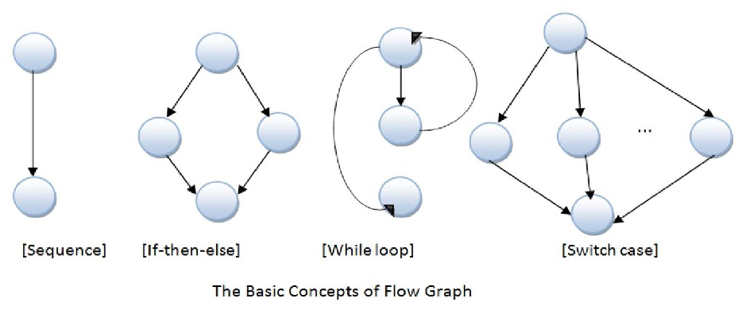
example
Notes:
Software Testing Metric is be defined as a quantitative measure that helps to estimate the progress, quality, and health of a software testing effort.
A Metric defines in quantitative terms the degree to which a system, system component, or process possesses a given attribute.
Software testing metrics or software test measurement is the quantitative indication of extent, capacity, dimension, amount or size of some attribute of a process or product.
https://www.360logica.com/blog/difference-between-defect-error-bug-failure-and-fault/

Slide 12
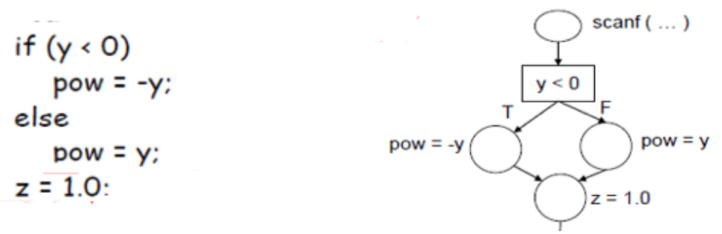
CFG – IF ELSE

Slide 13
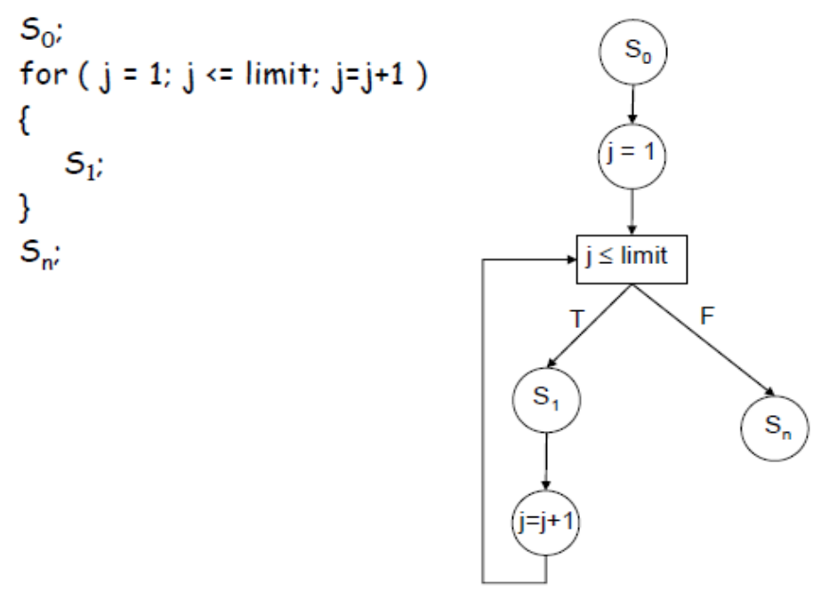
CFG – FOR LOOP

Slide 14
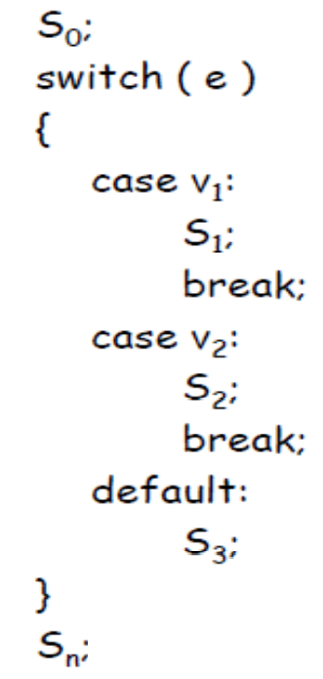
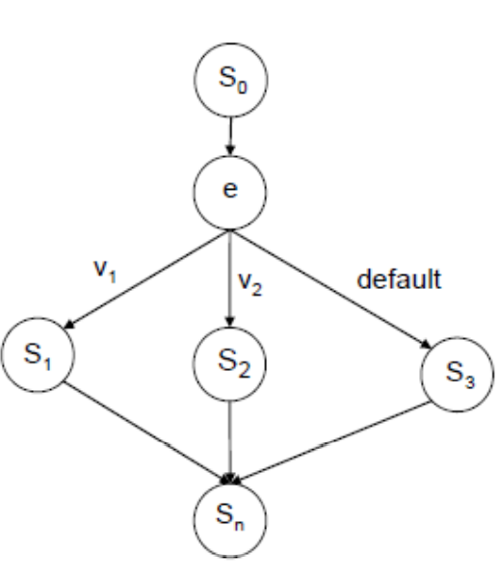
CFG – SWITCH CASE

Slide 15
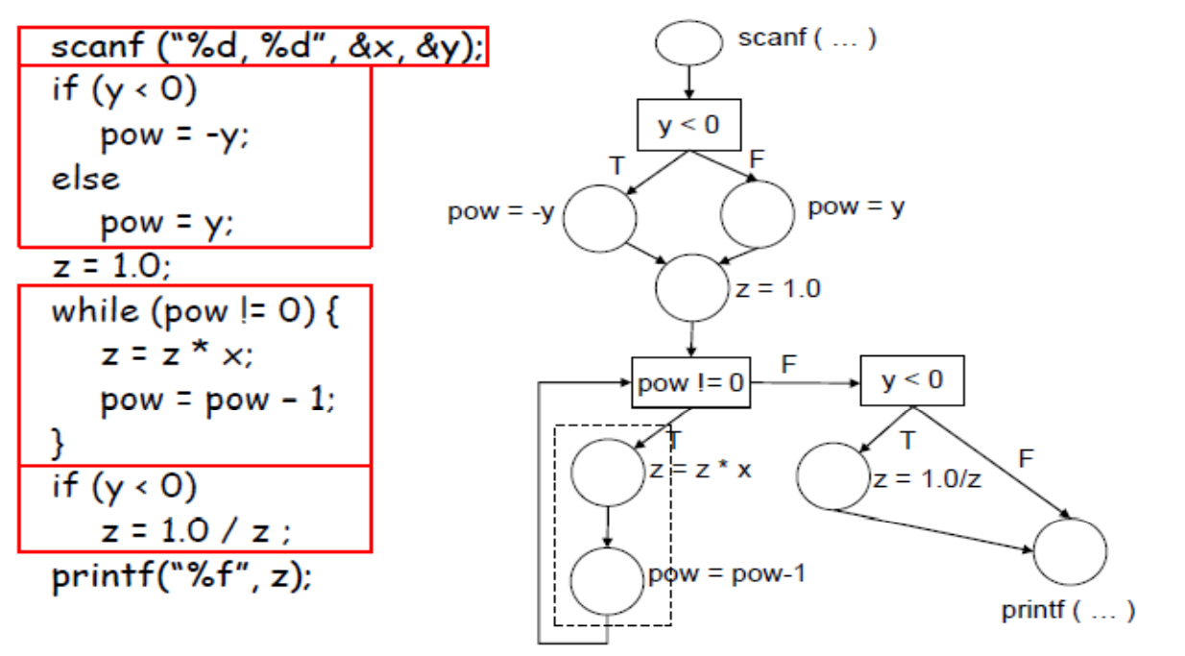
CFG – EXAMPLE 01

Slide 16
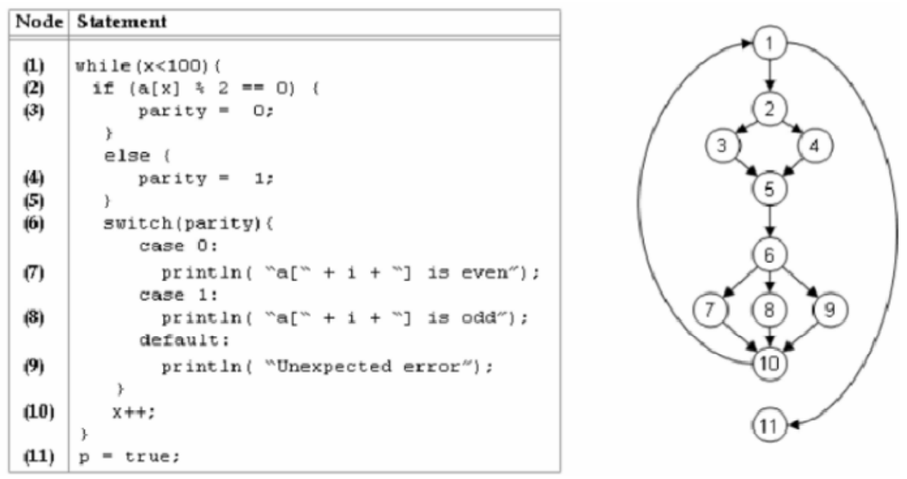
CFG – EXAMPLE 02

Slide 17
CFG – EXAMPLE 02

Slide 18
Cyclomatic Complexity

Slide 19
Cyclomatic Complexity
Cyclomatic complexity is a source code complexity measurement that is being correlated to a number of coding errors.
It is calculated by developing a Control Flow Graph of the code that measures the number of linearly-independent paths through a program module.
Lower the Program's cyclomatic complexity, lower the risk to modify and easier to understand.

Slide 20
Cyclomatic Complexity
It can be represented using the below formula:
Cyclomatic complexity = E - N + 2*P
where,
E = number of edges in the flow graph.
N = number of nodes in the flow graph.
P = number of nodes that have exit points

Slide 21
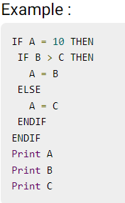
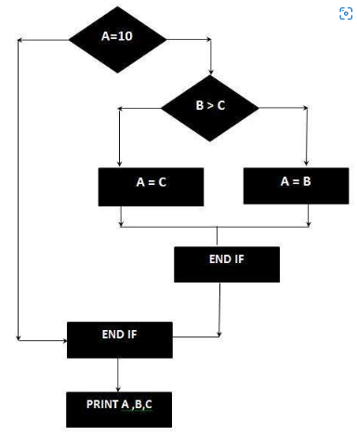
Example
The Cyclomatic complexity is calculated using the above control flow diagram that shows seven nodes(shapes) and eight edges (lines), hence the cyclomatic complexity is 8 - 7 + 2 = 3

Slide 22
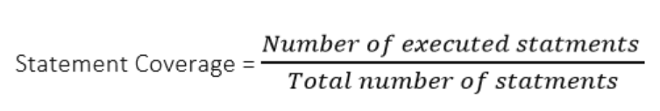
Statement testing
Statement testing A white box testing technique strategy in which each statement of a program is executed at least once.
It is equivalent to finding a path (or set of paths) through the control-flow graph that contains all the nodes of the graph.
It is used for calculation of the number of statements in source code which have been executed.
The main purpose of Statement Coverage is to cover all the possible paths, lines and statements in source code.

Slide 23
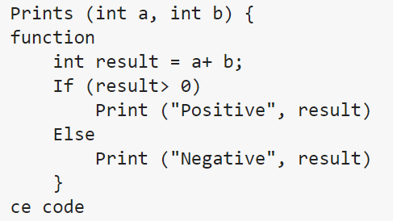
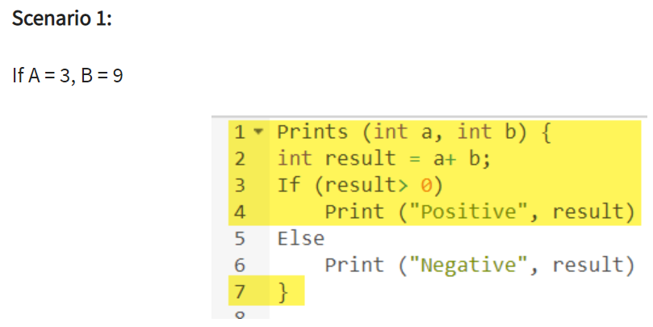

The statements marked in yellow color are those which are executed as per the scenario Number of executed statements = 5 Total number of statements = 7 Statement Coverage: 5/7 = 71%

Slide 24
Decision Coverage/ Branch coverage
Decision coverage or Branch coverage is a testing method, which aims to ensure that each one of the possible branch from each decision point is executed at least once and thereby ensuring that all reachable code is executed.
That is, every decision is taken each way, true and false. It helps in validating all the branches in the code making sure that no branch leads to abnormal behavior of the application.

Slide 25
Decision Coverage / Branch coverage - CONT
Causes every decision (if, switch, while, etc.) in the program to be made both ways (or every possible way for switch)
System: Design a test case to exercise each decision in the program each way (true / false)
Completion criterion: A test case for each side of each decision can be checked by track branches taken in execution

Slide 26
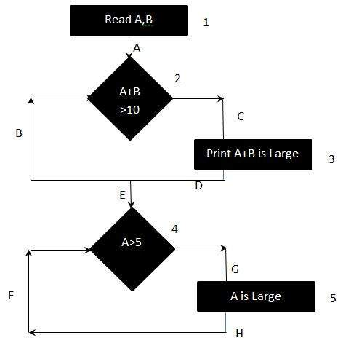
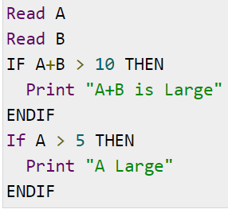
Example
To calculate Decision Coverage, one has to find out the minimum number of paths which will ensure that all the edges are covered. In this case there is no single path which will ensure coverage of all the edges at once. The aim is to cover all possible true/false decisions.
(1) 1A-2C-3D-E-4G-5H
(2) 1A-2B-E-4F
Hence Decision or Decision Coverage is 2.

Slide 27
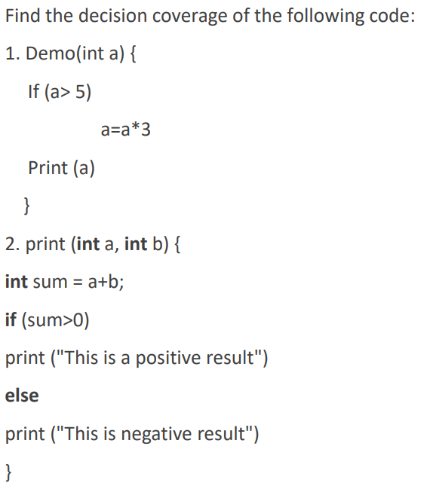
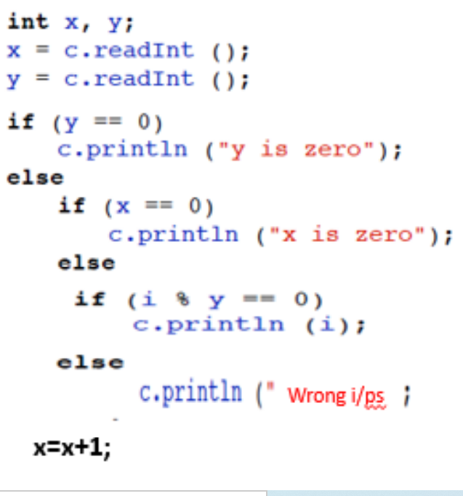
EXAMPLES

Slide 28
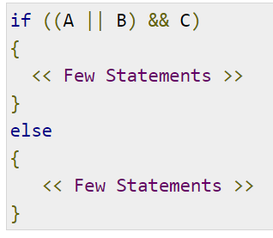
Condition Coverage
Condition coverage is also known as Predicate Coverage in which each one of the Boolean expression have been evaluated to both TRUE and FALSE. Like decision coverage, but causes every condition expression to be exercised both ways (true / false)
In order to ensure complete Condition coverage criteria for the above example, A, B and C should be evaluated at least once against "true" and "false".
So, in our example, the 3 following tests would be sufficient for 100% Condition coverage testing.
A = true | B = not eval | C = false
A = false | B = true | C = true
A = false | B = false | C = not eval

Slide 29
Condition Coverage
A condition is any true / false subexpression in a decision
Example: if (( x == 1 || y > 2) && z < 3)
Requires separate condition coverage tests for each of:
x == 1 true / false
y > 2 true / false
z < 3 true / false

Slide 30
Path Testing
Path testing is a structural testing method that involves using the source code of a program in order to find every possible executable path. It helps to determine all faults lying within a piece of code. This method is designed to execute all or selected path through a computer program.
Any software program includes, multiple entry and exit points. Testing each of these points is a challenging as well as time-consuming. In order to reduce the redundant tests and to achieve maximum test coverage, basis path testing is used.
Notes:
Basis Path Testing in software engineering is a White Box Testing method in which test cases are defined based on flows or logical paths that can be taken through the program. The objective of basis path testing is to define the number of independent paths, so the number of test cases needed can be defined explicitly to maximize test coverage.

Slide 31
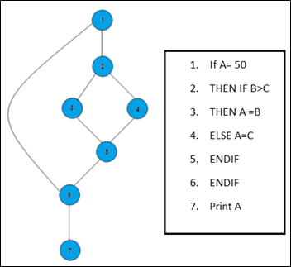
Example
In the above example, we can see there are few conditional statements that is executed depending on what condition it suffice. Here there are 3 paths or condition that need to be tested to get the output,
Path 1: 1,2,3,5,6, 7
Path 2: 1,2,4,5,6, 7
Path 3: 1, 6, 7

Slide 32
Steps for Basis Path testing
The basic steps involved in basis path testing include
Draw a control graph (to determine different program paths)
Calculate Cyclomatic complexity (metrics to determine the number of independent paths)
Find a basis set of paths
Generate test cases to exercise each path
Notes:
Advantages of Basic Path Testing
It helps to reduce the redundant tests
It focuses attention on program logic
It helps facilitates analytical versus arbitrary case design
Test cases which exercise basis set will execute every statement in a program at least once

Slide 33
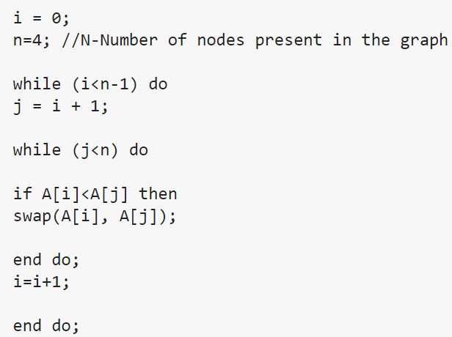
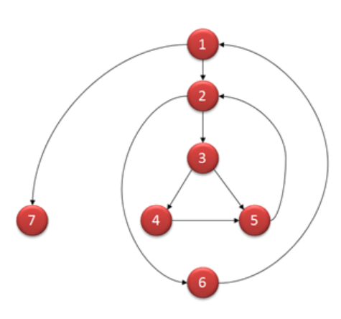
How to Calculate Cyclomatic Complexity

Slide 34
cont…
Mathematically, it is set of independent paths through the graph diagram. The Code complexity of the program can be defined using the formula –
V(G) = E - N + 2
Where,
E - Number of edges
N - Number of Nodes
V(G) - the maximum number of independent paths in the graph
V (G) = P + 1
Where P = Number of predicate nodes (node that contains condition)

Slide 35
Computing mathematically - CONT…
V(G) = 9 - 7 + 2 = 4
V(G) = 3 + 1 = 4 (Condition nodes are 1,2 and 3 nodes)
Basis Set - A set of possible execution path of a program
1, 7
1, 2, 6, 1, 7
1, 2, 3, 4, 5, 2, 6, 1, 7
1, 2, 3, 5, 2, 6, 1, 7
Notes:
Advantages of Basic Path Testing
It helps to reduce the redundant tests
It focuses attention on program logic
It helps facilitates analytical versus arbitrary case design
Test cases which exercise basis set will execute every statement in a program at least once

Slide 36
Decision-to-decision path
A decision-to-decision path, or DD-path, is a path of execution (usually through a flow graph representing a program, such as a flow chart) between two decisions.
More recent versions of the concept also include the decisions themselves in their own DD-paths.

Slide 37
DD-paths:
1-2
2-3-4-5
5-6-7-8
5-7-8
8-4-5
8-9
9-10-12-2
9-11-12-2
2-13

